Slide 1
DATA STRUCTURES
INTRODUCTION

Slide 2
What is DATA STRUCTURE?
Data structure is a particular way of storing and organizing data in a computer so that it can be used efficiently.
A data structure is a special format for organizing and storing data.
General data structure types include arrays, files, linked lists, stacks, queues, trees, graphs and so on.

Slide 3
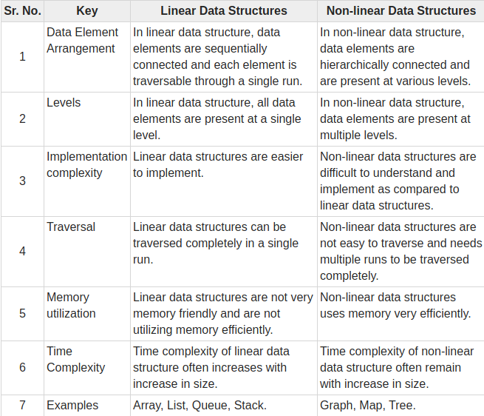
TYPES OF DATA STRUCTURES
Depending on the organization of the elements, data structures are classified into two types:

Slide 4
ABSTRACT DATA TYPES(ADT)
To simplify the process of solving problems, we combine the data structures with their operations and we call this Abstract Data Types (ADTs). An ADT consists of two parts:
1.Declaration of data
2.Declaration of operations
Commonly used ADTs include: Linked Lists, Stacks, Queues, Priority Queues, Binary Trees,Dictionaries, Disjoint Sets (Union and Find), Hash Tables, Graphs, and many others.

Slide 5
What is an algorithm?
The formal definition of an algorithm can be stated as:
An algorithm is the step-by-step unambiguous instructions to solve a given problem.
Why the Analysis of Algorithms?
Goal of the Analysis of Algorithms...

Slide 6
What is Running Time Analysis?
It is the process of determining how processing time increases as the size of the problem (input size) increases.
Input size is the number of elements in the input, and depending on the problem type, the input may be of different types.
The following are the common types of inputs.
Size of an array
Polynomial degree
Number of elements in a matrix
Number of bits in the binary representation of the input
Vertices and edges in a graph

Slide 7
How to Compare Algorithms?
To compare algorithms, let us define a few objective measures:
Execution times? Not a good measure as execution times are specific to a particular computer.
Number of statements executed? Not a good measure, since the number of statements varies with the programming language as well as the style of the individual programmer.
Ideal solution? Let us assume that we express the running time of a given algorithm as a function of the input size n (i.e., f(n)) and compare these different functions corresponding to running times. This kind of comparison is independent of machine time, programming style, etc

Slide 8
Big O notation
Simplified analysis of an algorithm’s efficiency.
Big O notation is a system for measuring the rate of growth of an algorithm.
Used to analyze time and space complexity.
It gives
Complexity in terms of input size,N
Machine independent
Basic computer steps

Slide 9
TYPES OF MEASUREMENTS
Worst case
Defines the input for which the algorithm takes a long time (slowest time to complete).
○Input is the one for which the algorithm runs the slowest.
Best case
Defines the input for which the algorithm takes the least time (fastest time to complete).
Input is the one for which the algorithm runs the fastest.

Slide 10
CONTD...
Average case
Provides a prediction about the running time of the algorithm.
Run the algorithm many times, using many different inputs that come from some distribution that generates these inputs, compute the total running time (by adding the individual times), and divide by the number of trials.
○Assumes that the input is random.
Lower Bound <= Average Time <= Upper Bound

Slide 11
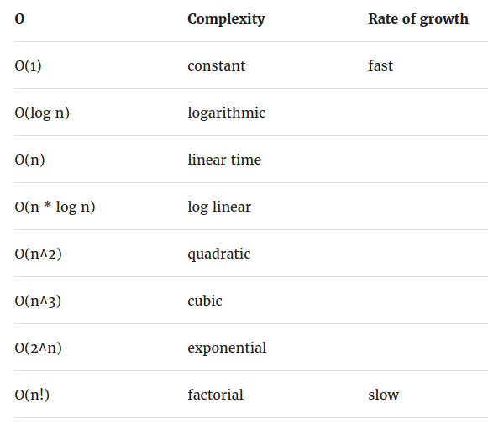
contd

Slide 12
General rules
Ignore constants
Certain terms “dominate” others
O(1)<O(log n)<O(n)<O(n logn )O(n²)<O(2^{n})<O( n! )
I.e. ignore low order terms

Slide 13
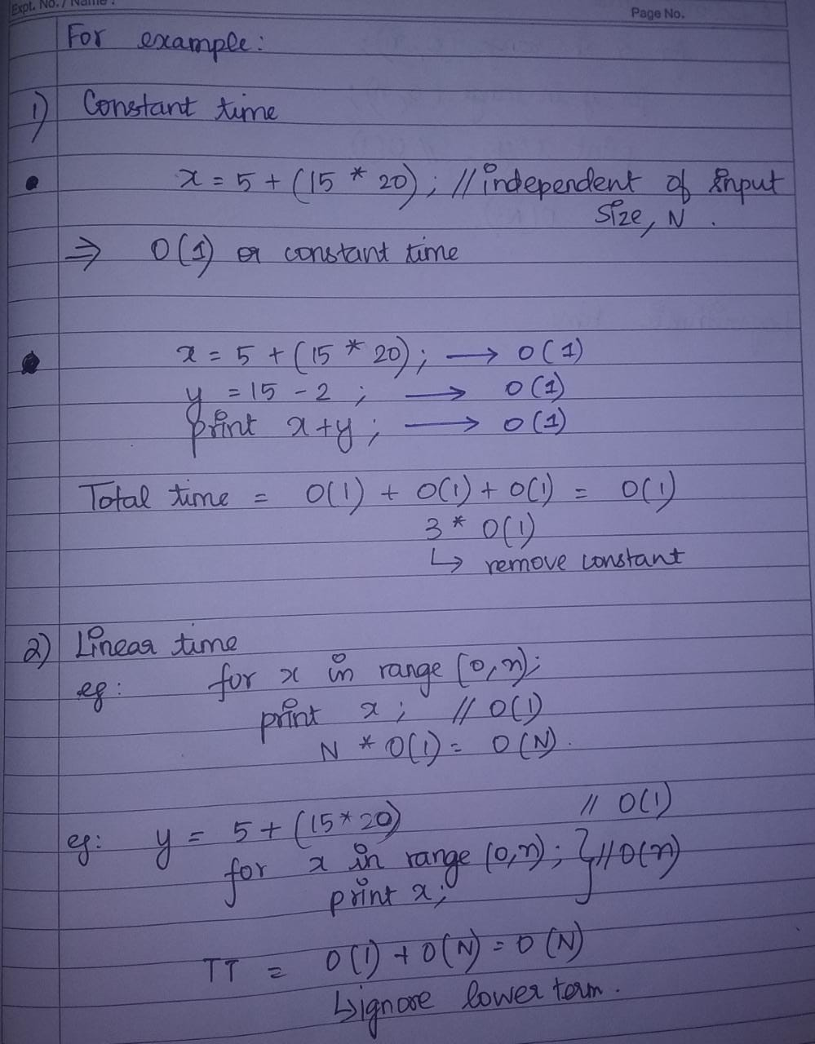
example

Slide 14
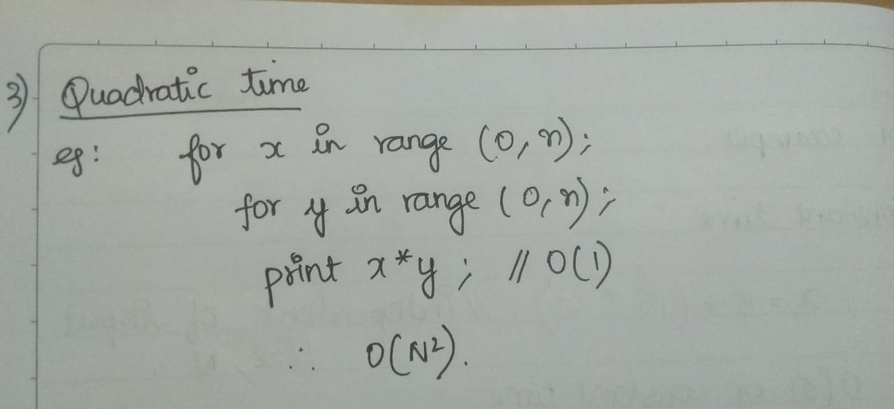

Slide 15
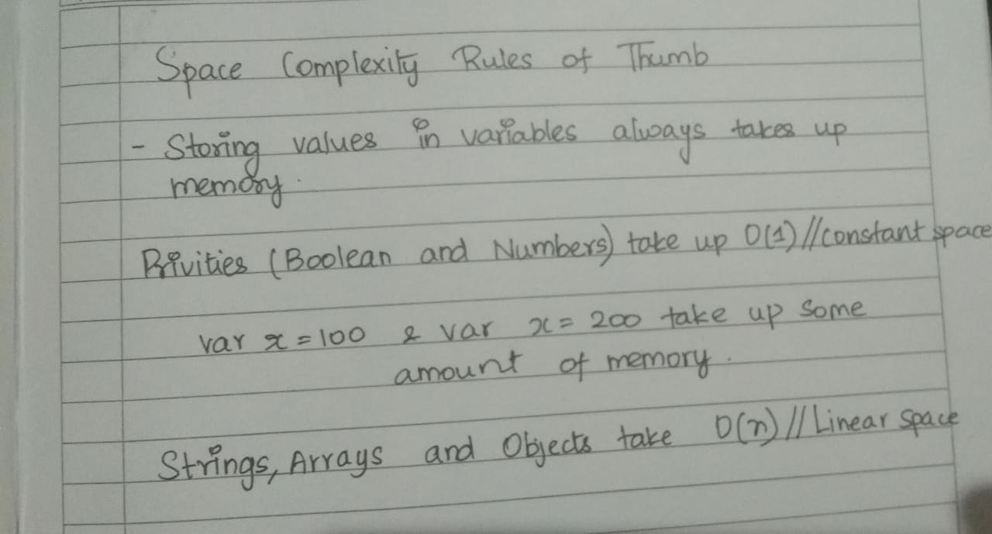
Calculating Space Complexity
For calculating the space complexity, we need to know the value of memory used by different type of data type variables, which generally varies for different operating systems, but the method for calculating the space complexity remains the same.

Slide 16
ARRAYS
An array is a collection of items stored at contiguous memory locations.
The idea is to store multiple items of the same type together.
This makes it easier to calculate the position of each element by simply adding an offset to a base value, i.e., the memory location of the first element of the array (generally denoted by the name of the array).

Slide 17
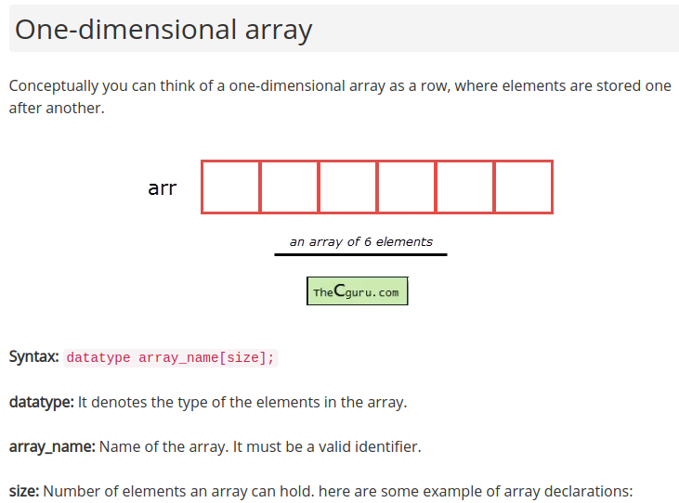
ONE DIMENSIONAL ARRAY

Slide 18
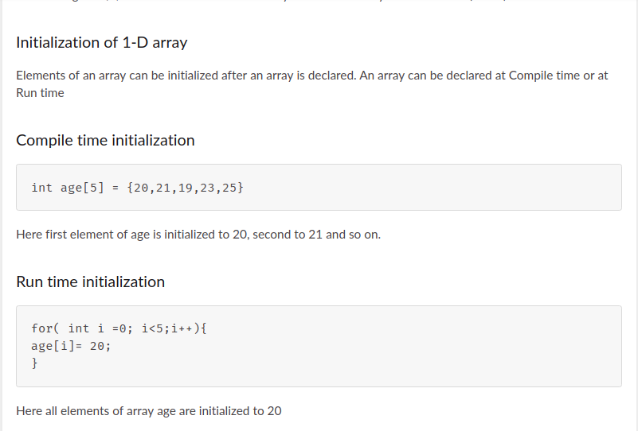

Slide 19
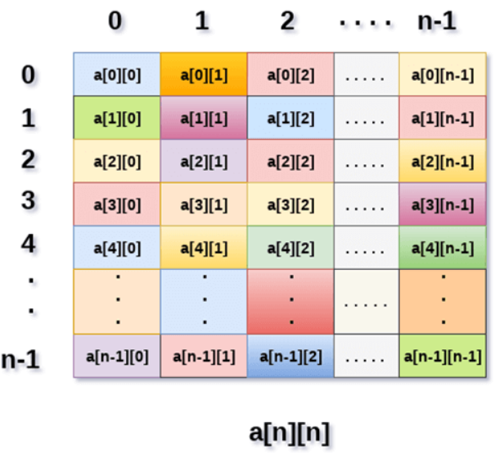
TWO DIMENSIONAL ARRAYS
2D array can be defined as an array of arrays.
The 2D array is organized as matrices which can be represented as the collection of rows and columns.
However, 2D arrays are created to implement a relational database look alike data structure.
It provides ease of holding bulk of data at once which can be passed to any number of functions wherever required.
SYNTAX
First element of the first row is represented by a[0][0]
No. in the first index is the number of that row
No. in the second index is the number of the column.
int arr[max_rows][max_columns];

Slide 20
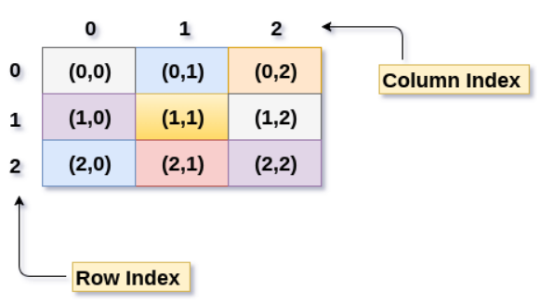
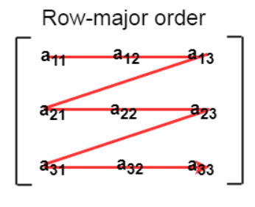
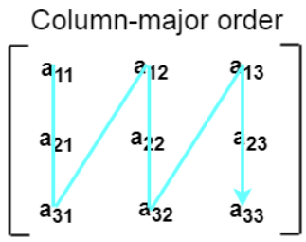
ROW MAJOR ORDER & COLUMN MAJOR ORDER

Slide 21
Formulas:
Row major order :Address(a[i][j]) = B. A. + (i * n + j) * size
Column major order: Address(a[i][j]) = ((j*m)+i)*Size + BA

Slide 22
Multi-dimensional arrays
You can initialize a three-dimensional array in a similar way like a two-dimensional array. Here's an example,
int test[2][3][4] = {
{{3, 4, 2, 3}, {0, -3, 9, 11}, {23, 12, 23, 2}},
{{13, 4, 56, 3}, {5, 9, 3, 5}, {3, 1, 4, 9}}};

